Slide 1
El sueño en los niños. Desmontando falsos mitos.
Dr. Gonzalo Pin Arboledas. Unidad Pediatría Integral. Hospital Quironsalud. Valencia.

Slide 2
Conflictos de intereses
Dr. Gonzalo Pin Arboledas ha participado en charlas promocionales por los laboratorios Exeltis, Humana y Ordesa relacionados con este tema.

Slide 3
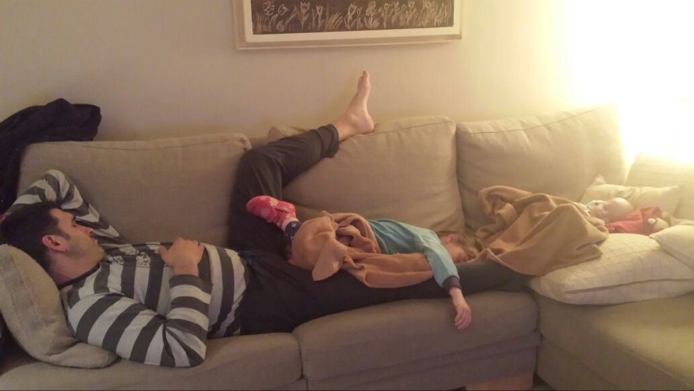
NUESTRA AGENDA HOY
1º TEORÍA: ALGUNAS IDEAS SOBRE CRONOBIOLOGÍA.
2º SITUACIONES CLÍNICAS: “PRIMUN NON NOCERE”.

Slide 4
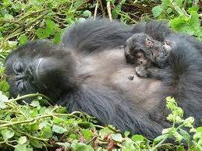

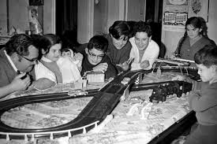

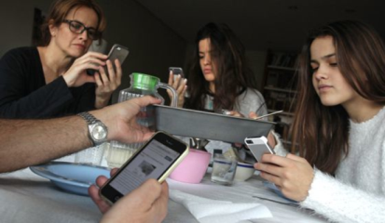


13 millones de años
300.000 años
S. preindustrial: 1er y 2º sueño
1879
Siglo XX
Notes:
Simon Neubauer and colleagues (2018, Science Advances) document a gradual change within Homo sapiens, from an elongated endocranial shape towards a more globular one. Two features of this process stand out: parietal and cerebellar bulging. Parietal brain areas are involved in orientation, attention, perception of stimuli, sensorimotor transformations underlying planning, visuospatial integration, imagery, self-awareness, working and long-term memory, numerical processing, and tool use. The cerebellum is not only associated with motor-related functions like the coordination of movements and balance, but also with spatial processing, working memory, language, social cognition, and affective processing. The Homo sapiens fossils were found to have increasingly more modern endocranial shapes in accordance with their geological age. Only fossils younger than 35,000 years show the same globular shape as present-day humans, suggesting that modern brain organization evolved some time between 100,000 and 35,000 years ago. Importantly, these shape changes evolved independently of brain size — with endocranial volumes of around 1,400 milliliters, even the oldest Homo sapiens fossils from Jebel Irhoud fell within present-day variation of brain size

Slide 5









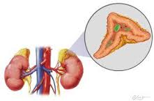
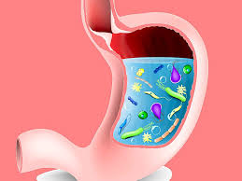

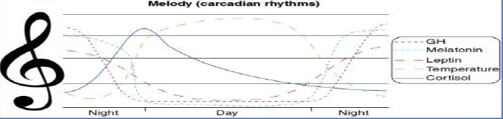
CRONOTIPOS
HÁBITOS SOCIALES
RELOJERO FACILITADOR/INHIBIDOR
RELOJ CENTRAL
>24 H
SEROTONINA
LUZ/OSCURIDAD
RELOJERO JEFE
OSCURIDAD: SNA
MELATONINA
MELATONINA + SNA: MENSAJEROS
CRONODISRUPCIÓN
A.FISICA-STRESS
RELOJERO DESORGANIZADOR
Triptófano(dieta)
ALIMENTACION/AYUNO
RELOJERO ADJUNTO AL JEFE
Estrés
Actividad física
Alimentos + Microbiota
RESTO ORGANISMO
RELOJES PERIFERICOS
Notes:
The SCN controls feeding and activity rhythms producing 24 h variation in the nutrient state of peripheral tissues.
El patrón de sensibilidad rítmica de muchas hormonas nutricionales varía en respuesta a condiciones ambientales y conductuales como el horario de la ingesta. Las cenas tardías favorecen la tendencia a obesidad y diabetes tipo 2.
El 35% de la composición de la microbiota varía a lo largo del día al parecer en función de la composición de la dieta, los hábitos alimenticios y el momento del día; estos cambios de la microbiota modulan el sistema inmune del huésped al modular el metabolismo del triptófano.
Only 1% of dietary TRP is used for brain 5-HT synthesis. TRP use for synthesis of niacin is via the oxidatyve kyneurine pathway. A further route for TRP metabolism is via degradation by gut microbiota, which can lead to production of both positive and detrimental active metabolites , including quinolinic acid; therefore, individual variation in the gut microbiome may have implications for TRP metabolism and thus brain health and psychological well being. (Dinan TG, Cryan JF. Gut instincs:microbiota as key regulator of brain development, ageing and neurodegeneration. J Physil.2017;595:489-503
The metabolism of TRP for the synthesis of 5-HT is catalysed by the rate-limiting enzyme TRP hydroxylase (TPH) with converts TRP into 5-hydroxytryptophan. In turn, 5-hydroxytriptophan is decarboxylated to 5-HT by enzyme aromatic amino acid decarboxylase.
The key observation for this pathway is that TPH is not fully saturated by its substrate TRP under normal conditions,so that raising brain TRP levels could increase serotnin synthesis.
Brain TRP levels are buffered from plasma TRP by the blood-brain berrier: to be transported into the brain, TRP has to compete for uptake across the blood-brain barrier against other amino acid in particular the large neutral amino acids (LNAA) leucine,isoleucine, valine,phenylalanina and tyrosine: Thus the ratio of plasma or serum TRP to LNAA is recognised as the best peripheral biomarker of uptake of TRP into the brain.
Food or drink that stimulates insulin relaese and so prmotes uptake of NEFA into tissue wil tend to reduce the availability of free plasma TRP, but at the same time will remove competing LNAA from plasma into tissue. Thus measuring both free and total TRP may ensure better prediction of TRP entry into the brain and its behavioural associations.
The clock in the gut has been shown to participate in the daily cycles of food digestión (Hussain, 2014; Tahara and Shibata, 2013), as well as in coping with the pathogenic condition of Salmonella infection (Bellet et al., 2013) and regulation of interleukin-17-producing CD4+ T helper (TH17) cells that protect against bacterial and fungal infections at mucosal surfaces (Yu et al., 2013).
Irregular eating habits may reduce HDL. In other words, regular eating habits may decrease “bad” colesterol and increase “good” colesterol.
The circadian clock within intestinal epithelial cells (IECs) is responsible for cyclic glucocorticoid production and is under endocrine control from the pituitary-adrenal axis. Remarkably, the IECs clock is profoundly disrupted by depletion of the microbiota, leading to altered corticosteroids levels and consequent metabolic disorders. Thus, the microbiota determines the appropriate function of the gut clock, most likely contributing to additional, system-wide cyclic homeostasis.The influence that the microbiota appears to have on neuronal functions (Mayer et al., 2014) begs the question
of whether the central clock or other brain structures may be receiving ‘‘nutritional’’ information in a cyclic manner through the gut-microbiota interplay.
Cell 161, March 26, 2015.
It should not be surprising that the intestinal microbiana plays a critical role in the development of the brain itself from the time of birth.
Douglas E, Elliott E, Neo J. Effect of intestinal microbial ecology on the developing brain. ] AMA Pediatr 2013.5167: 374 -379

Slide 6
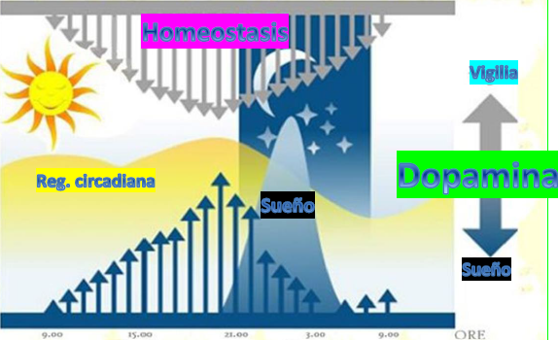

Slide 7
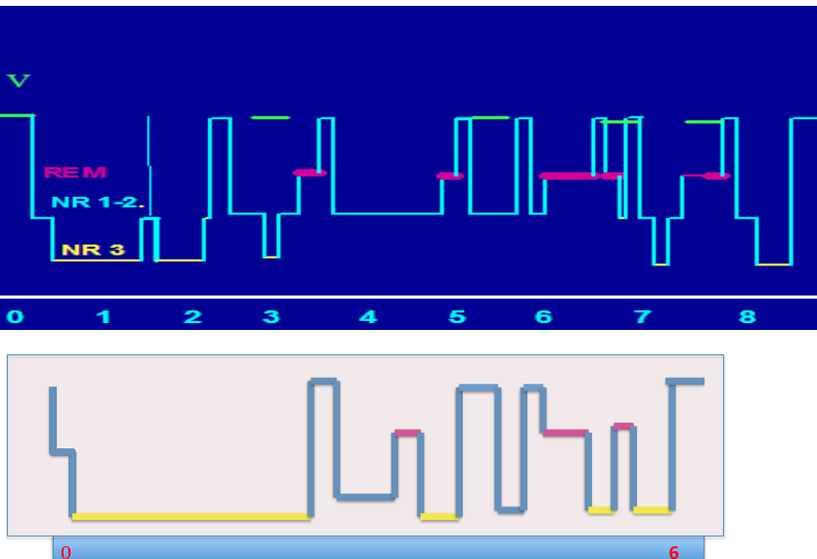

Slide 8
Pregunta 1
Al valorar el sueño en un niño:
Hasta el año los cronotipos no influyen en la calidad del sueño.
Debemos valorar la intensidad de la luz previa al inicio del sueño, la actividad física y el horario de alimentación
Debemos valorar el tipo de luz previa al inicio del sueño, la actividad física y el horario de alimentación.
Debemos valorar el tipo de luz previa al inicio del sueño, la actividad física, el horario de alimentación de siestas.

Slide 9
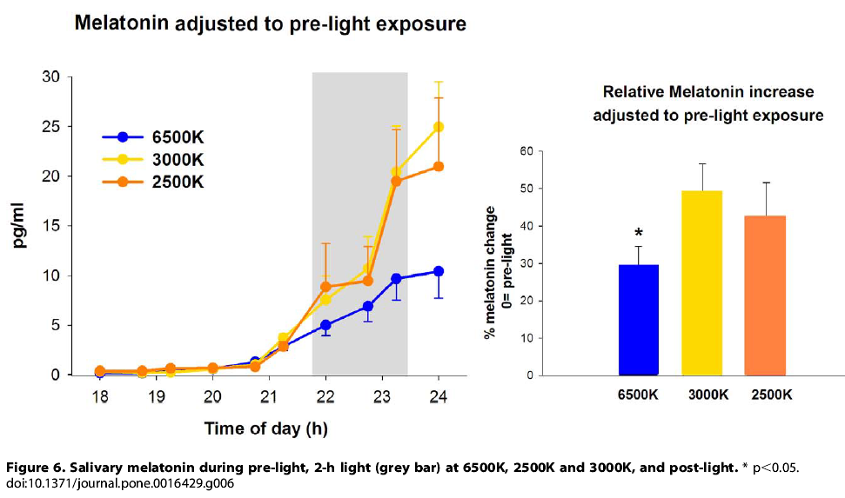
Notes:
light at 6500K resulted in attenuated melatonin secretion (adjusted to each individuals melatonin prelight values) in comparison to the other light conditions (main factor ‘‘light condition’’, F2,23 =4.1, p =0.04). These differences occurred mainly after 90 minutes of light exposure, and persisted during post-light exposure (Fig. 6). Comparison of salivary melatonin levels across different light conditions indicated that light at 6500K, 3000K and 2500K resulted, respectively, in an increase of 29.565%, 4967.6% and 4268.6% in comparison to pre-light exposure (1-way ANOVA, F2,17 = 2.1, p= 0.03).
Here we demonstrate that the alerting response to polychromatic light in the evening is wavelength-dependent, such that light at 6500K is more effective than light at 2500K and 3000K in reducing subjective sleepiness and enhancing cognitive performance, specifically associated with tasks of sustained attention.
the human circadian pacemaker is highly sensitive to short wavelength light night-time increases alertness .

Slide 10
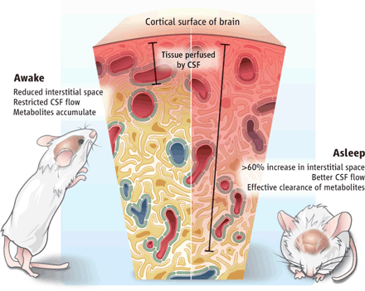

Corteza cerebral
Tejido bañado por el LCR
VIGILIA
Disminuye espacio entre neuronas.
Baja el flujo del líquido en el cerebro.
Acumula desechos neurotóxicos.
SUEÑO y cía
Recogida nocturna de basura
Ayuntament SALUT
SUEÑO
> 60% espacio entre neuronas.
Mejor flujo del liquido cerebral.
Limpieza del tejido cerebral.l
10TRC
e
Eliminación de la basura neurotóxica acumulada en el cerebro durante la vigilia.
Función reparadora del sueño
Herculano-Houzel, Science, 2013
Xie et al., Science, 2013
Notes:
natural sleep or anesthesia are associated with a 60% increase in the interstitial
space, resulting in a striking increase in convective exchange of cerebrospinal fluid with interstitial
fluid. In turn, convective fluxes of interstitial fluid increased the rate of amyloid b clearance
during sleep. Thus, the restorative function of sleep may be a consequence of the enhanced
removal of potentially neurotoxic waste products that accumulate in the awake central nervous
system.

Slide 11

MADRE-HIJO: SISTEMA ADAPTATIVO COMPLEJO
18 SG: RECEPTORES DE MELATONINA Y DOPAMINA EN SNC FETAL
Notes:
Our results demonstrate that maternal feeding entrains the fetal SCN and liver independently of both the maternal SCN and the LD cycle. This indicates that maternal-feeding signals can be more influential for the fetal SCN and particular organ oscillators than hormonal signals controlled by the maternal SCN, suggesting the importance of a regular maternal feeding schedule for appropriate fetal molecular clockwork during pregnancy
In humans, melatonin and dopamine receptors appear as early as gestational week 18 in the fetal SCN, suggesting melatonin and dopamine may serve as the primary communicators of circadian information for the fetus. Melatonin from the mother readily passes through the placenta and the fetal blood–brain barrier and may thus be the predominant relay of time- of-day information to the fetus, particularly during the transition from dusk to night, as circulating melatonin rises.
Circadian rhythms of melatonin along with corticosteroid are detectable in the umbilical artery and vein, along with fetal circulation. Fetal rhythms are also entrained by maternal core body temperature, feedingand hormone reléase.
Abnormal sleep, feeding and work schedules might disrupt maternal rhythms, such as melatonin fluctuations, and thus desynchronize the maternal SCN from peripheral oscillators and lead to deleterious effects of shift- work on the fetus.

Slide 12
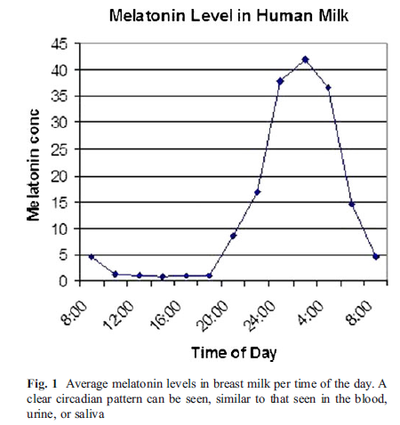
MADRE-HIJO: SISTEMA ADAPTATIVO COMPLEJO
Algunos efectos de la melatonina están regulados por el gen MIR-16 que se expresa con ritmo circadiano en la leche materna.
Breastfeeding may improve nocturnal sleep and reduce infantile colic: Potential role of breast milk melatonin. Eur J Pediatr (2012) 171:729–732
Notes:
El aumento nocturno de la melatonina pineal materna aumenta la melatonina sanguínea la cual es trasferida a la leche materna. De esta manera, la leche materna nocturna tiene mayor contenido de antioxidantes, antiinflamatorios y efectos reguladores inmunes por lo que tiene un gran impacto en el desarrollo de la microbiota del niño y en la permeabilidad intestinal con consecuencias en el desarrollo del sistema inmune el cual, a su vez, está claramente influenciado por factores circadianos. Muchos de los factores de los componentes de la lactancia materna que sustentan los beneficios de la lactancia materna están regulados por la melatonina lo que sugiere que la actividad melatoninergica materna modula en gran medida los beneficios de la lactancia materna.
Algunos efectos de la melatonina están regulados por el gen MIR-16 que se expresa con ritmo circadiano en la leche materna: hay una interacción entre melatonina, ritmo circadiano y mRNA en los efectos de los componentes de la leche materna de manera que alteraciones en la via melatoninergica materna pueden tener un impacto significativo en los componentes de la LM y en la regulación intestinal del niño y su sistema inmune.
Como conclusión:
Es muy importante el respeto al ritmo circadiano materno el ultimo trimestre del embarazo ( relación cortisol-melatonina) y el primer cuatrimestre de la vida del niño
En los primeros meses de vida en los que no hay ritmo circadiano la concentración sérica de melatonina de origen digestivo es fundamental por lo que un ayuno prolongado artificialmente por la noche podría favorecer la disminución patológica de melatonina sérica (Pin).La toma nocturna de leche materna se debe respetar hasta que el establecimiento del ritmo circadiano en el niño la suprima gradualmente.
Short-term fasting in humans for two days reduces nocturnal concentrations of melatonin in serum Rojdmark S, Wetterber L. Short-term fasting inhibits the nocturnal melatonin secretion in healthy man. Clin Endocrinol (Oxf), 1989. 30(4): p. 451–7
Based on the known properties of the hormone, hypnosis and, it is plausible that the nocturnal melatonin provided to the breast-fed infant results in reduced gastrointestinal activity and therefore less infantile colic as well as promoting nocturnal sleep. Previous studies found that melatonin is absorbed through the infant gastrointestinal tract and few studies demonstrated that external melatonin added to infants' nutrition resulted in earlier development of circadian rhythm and in improved nocturnal sleep.
Short-term fasting in humans for two days reduces nocturnal concentrations of melatonin in serum Rojdmark S, Wetterber L. Short-term fasting inhibits the nocturnal melatonin secretion in healthy man. Clin Endocrinol (Oxf), 1989. 30(4): p. 451–7
En los primeros meses de vida en los que no hay ritmo circadiano la concentración sérica de melatonina de origen digestivo es fundamental por lo que un ayuno prolongado artificialmente por la noche podría favorecer la dismiución patológica de melatonina sérica (Pin)

Slide 13
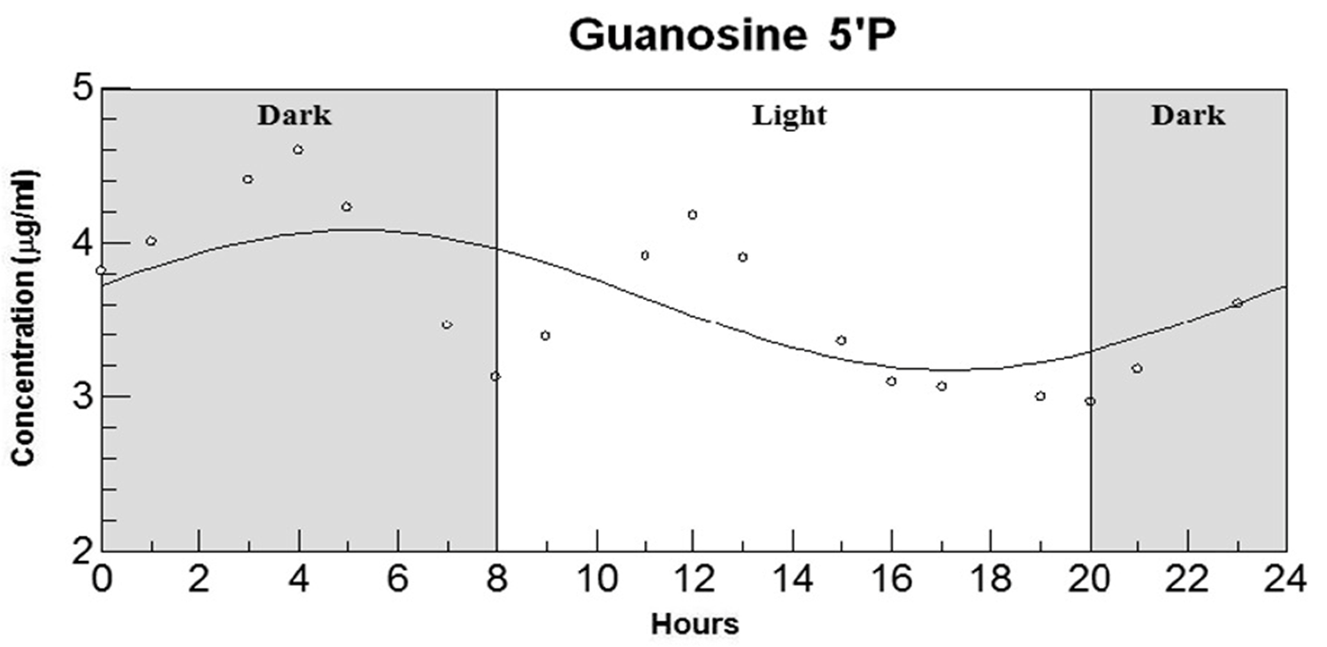


MADRE-HIJO: SISTEMA ADAPTATIVO COMPLEJO
Sánchez C et al. Nutritional Neuroscience 2009 ;12.

Slide 14

Crono-nutrición
“Horarios de alimentación coordinados con los biorritmos diarios”
Composición de los alimentos: regula el reloj biológico:
  Rica en grasa:
    Ritmo de la lipogénesis, lípidos circulantes, actividad locomotora, conducta alimenticia.
  Restricción calórica:
    Puede afectar circadiana del reloj central.
Horario: Afecta las salidas del reloj biológico.
  No desayunar, alimentación nocturna:
    Riesgo de obesidad.
  Ritmo de alimentación/ayuno:
    Prevenir alteraciones metabólicas inducidas por dietas ricas en grasa.

Slide 15
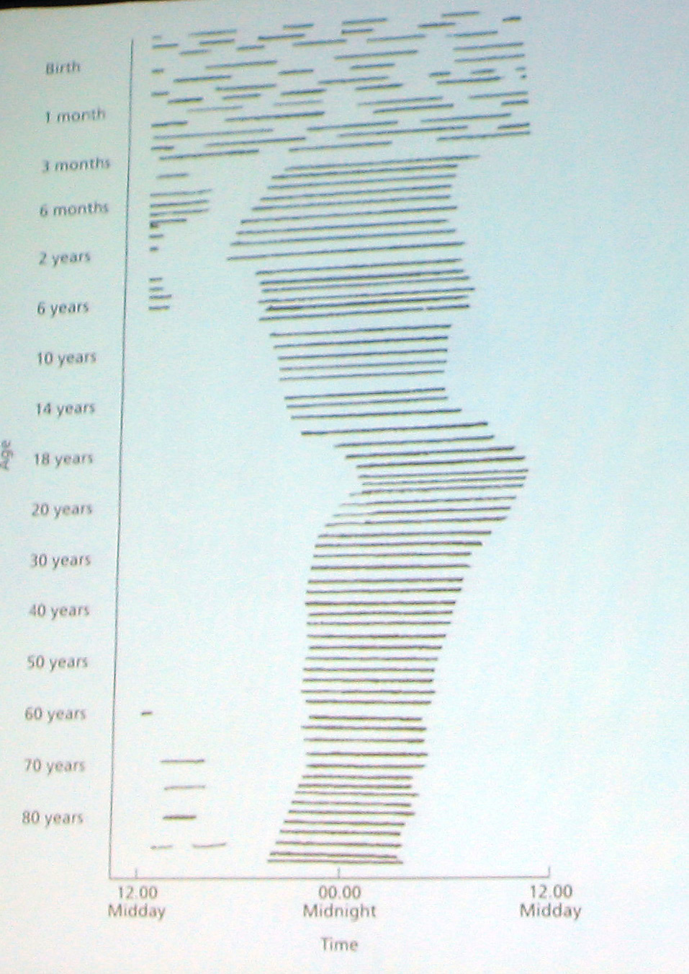

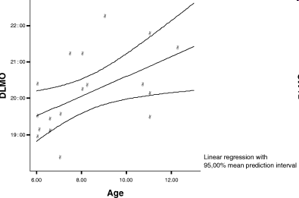
Evolución a lo largo de la vida
Desaparición de la siesta:
patrón secreción de cortisol semejante al adulto
Journal Sleep Research.2005;14(2):187-194

Slide 16
Pregunta 2
Al valorar el sueño en un niño, sabemos que:
La etapa perinatal condiciona el patrón de sueño desde el nacimiento.
La melatonina no atraviesa la placenta.
El ritmo de alimentación materna condiciona los patrones del sueño desde el 5 mes de vida.
Las ultimas semanas de gestación y la lactancia materna son importantes en el desarrollo de los patrones de sueño.

Slide 17
SINTOMAS SOSPECHOSOS DE PATOLOGÍA MÉDICA SUBYACENTE (8 - 18 MESES)
> tres despertares nocturnos
+
>60 m de vigilia intrasueño.
ó
2. TTS diario < 9 horas.
Basado en: Mindell et al. Infant Behavior and Development 49 (2017) 220–227

Slide 18
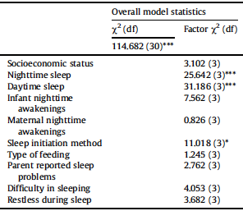
¿Podemos prevenir los problemas con el sueño a los 12 meses?
3 MESES: Predictores de > despertares
Formula artificial
Trato conductual para inicio de sueño.
6 MESES: Predictores de > TTS
TTS Diurno
Inicio de sueño independiente.
S. Sette et al. / Sleep Medicine 36 (2017) 78e85
Notes:
An interesting finding in our study is that infants who slept 10 h at 12 months were those with a nonindependent sleep initiation method (eg, breastfeeding, holding, rocking) at six months, compared to those who slept 15 h in total. However, an independent sleep initiation method at three months contributed to an increase in night awakenings at 12 months. Although surprising, we might hypothesize that an early autonomy in falling sleep at three months, when the abilities of self-soothing and emotional regulation are not yet developed, may be linked to a lack of parental sensitivity to the child's emotional needs. Because infants, especially in the first months of life, rely on parents for their emotional and behavioral regulation and only successively, with the improvement in self-regulation abilities, learn how to control their own behaviors [38,39], the adoption of strategies to fall sleep independently too early in the infant's life might cause difficulty in promoting sleep self-regulation. On the contrary, an excessive parental attitude to put infants to sleep, later at six months, when infants start to be able to regulate their own sleep through selfsoothing behaviors [40], may represent an interference in the experience of falling asleep independently, thus contributing to the occurrence of sleep disturbances at 12 months [4]. From this perspective, we think that our study adds a novel contribution to the field, as it highlights the importance of having parental support

Slide 19
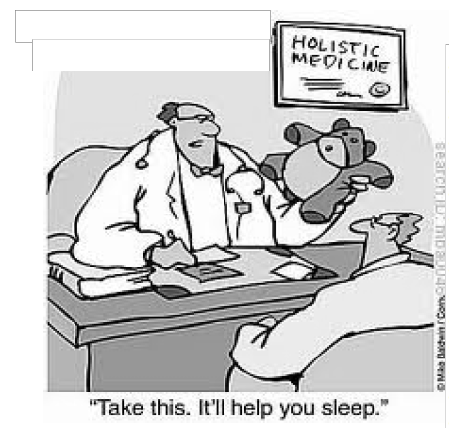

TRATAMIENTO
VALORACIÓN DEL SUEÑO: AGENDA + CUESTIONARIOS
HIGIENE DE SUEÑO
POSIBILIDAD DE PROBLEMAS MÉDICOS
ETILOGICOS Y/O CONDICIONANTES
¿PATRONES DE SUEÑO ACORDES CON LA EDAD?:
NO
CONFIRMACIÓN
+
NO CONFIRMACIÓN
SÍ
DERIVACIÓN ESPECIALISTA
UNIDAD/LABORATORIO DE SUEÑO
o
INICIO TRATAMIENTO MEDICO.
CONSIDERAR:
RITMO CIRCADIANO
F.CONDUCTUALES
AJUSTAR EXPECTATIVAS PATERNAS
¿?
¿?
TRATAMIENTO
Cognitivo – Conductual
Farmacológico específico
REEVALUAR
PERSISTENCIA: CONSIDERAR ALTERNATIVAS

Slide 20
Desregulación emocional
(permite des-culpabilizar a la persona)
“No quiere”
Castigos, premios para motivar.
Enseñar habilidades.
Modificaciones en el entorno.
Actitud más empática.
“No puede”
MODIFICAR EL ENTORNO FÍSICO (DORMITORIO)
MODIFICAR EL ENTORNO SOCIAL (DESACTIVAR)

Slide 21
Rutina del presueño
Desactivar
  Lugar: Fuera del dormitorio.
  Objetivo: Niveles de cortisol y Tª corporal.
  Duración: la necesaria.
Rutina propia del sueño:
Lugar: en el dormitorio del niño.
Objetivo: Reducir la incertidumbre.
Abrir la puerta al sueño: NO dormirlos.
Duración: 30-40m hasta que se apaga la luz (naranja).
Notes:
Changes in cortisol and core body temperature occur prior to sleep consolidation (Joseph et al., 2015) and another noted an association between cortisol and sleep regulation (Saridjan et al., 2017), thus supporting the role of core body temperature and cortisol as part of the sleep process

Slide 22
Factores personales – Factores familiares – Factores socioeconómicos – Factores circadianos
DESACTIVACIÓN FÍSICA ( 2 h)
Disminiuir cortisol y Tª
1.
( 30 – 40 m.)
Hábito rutinario.
Consistente.
Antes de apagar la luz.
2.
RUTINA DEL PRESUEÑO
Nutrición y sus ritmos
+
Higiene:
Hora actividad física, baño, dientes…
Comunicación:
Diálogo …
Tiempo de desconexión
Ambiente:
Luz,ruido,Tª,
Tecnología…
+
+
+
Componentes
Funciones
Autocuidado
y salud
Vínculo
Equilibrio protección-autonomía
Funcionamiento familiar
Regulación
emocional
3.
Gonzalo Pin,Mireia Pla
Adaptado de: Mindell,Williamson. Sleep Medicine Reviews.2017
RITMO VIGILIA -SUEÑO
Notes:
Rutina: a bath (minimum duration of 5 min), a massage (minimum duration of 3 min with suggested massage techniques), and quiet activities (e.g., cuddling, singing lullaby) with lights out within 30 min of the end of the bath.
One possible mechanism is that the institution of a routine reduces household chaos and/caregiver stress (Boles et al., 2017). Another possible, albeit speculative, reason for observing this fast change, particularly in sleep onset latency and sleep consolidation, may be that a bath and/or massage may impact elements of physiology, such as core body temperature or cortisol. Changes in cortisol and core body temperature occur prior to sleep consolidation (Joseph et al., 2015) and another noted an association between cortisol and sleep regulation (Saridjan et al., 2017), thus supporting the role of core body temperature and cortisol as part of the sleep process.
This intervention did not directly prescribe independent sleep onset, although studies have found that this factor is most highly predictive of sleep outcomes (e.g., Sadeh et al., 2009). In one way, this is relevant when working with families as a practitioner in that some families may not be comfortable allowing babies to fall asleep independently. Communicating to families that rapid change is possible with simple implementation of a three-step bedtime routine, even without formal sleep training, can be a highly useful clinical tool. It will be important for future research to address the rate and amount of change with a variation to the routine that targets self-soothing and falling asleep independently

Slide 23
Pregunta 3
En cuanto a la rutina del sueño:
No debe durar en conjunto más de 30-40 minutos.
Es más eficaz si se instaura desde el primer día.
Se debe realizar en un ambiente algo más frio pues la temperatura es un factor que ayuda al inicio del sueño.
Exige el paso previo de la desactivación familiar.

Slide 24

Manejo de una agenda de sueño
@PediaQuironVlc

Slide 25
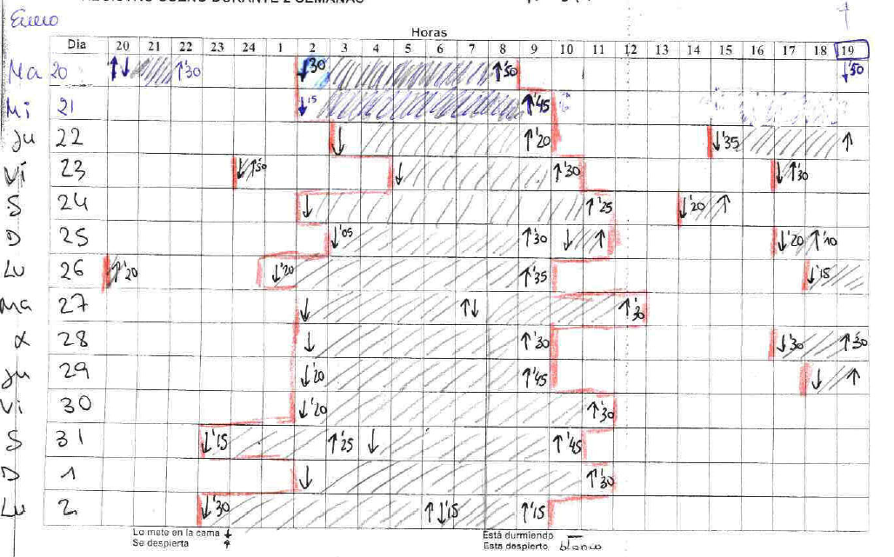
Agenda/diario libre de sueño

Slide 26
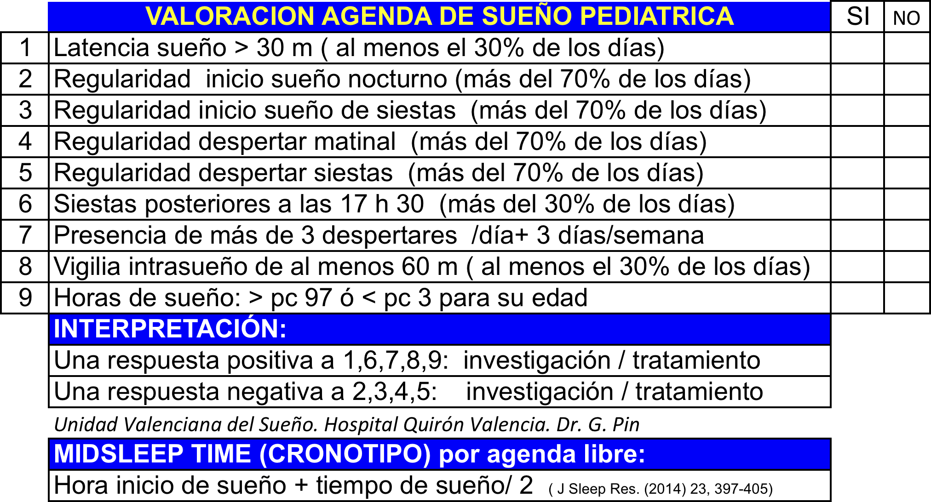

Slide 27
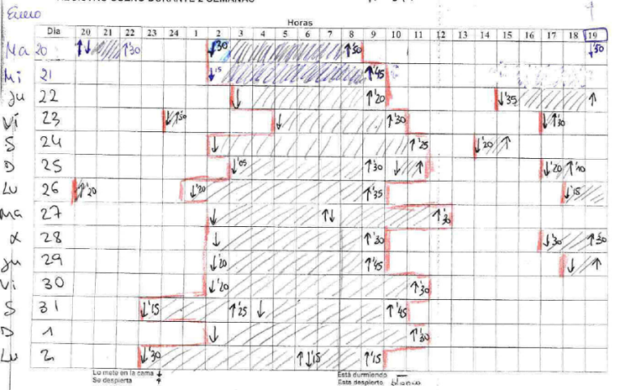
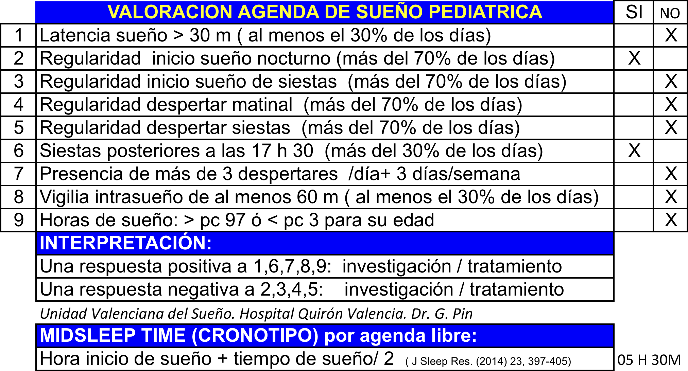

Slide 28
Caso clínico 1
Edad: 1 año 1 mes. M.C.
Desde hace 6 meses no quiere dormirse. No llora , quiere jugar. Se duerme a las 6 de la mañana y se despierta a las 13 h. Tiene mucho genio. Obsesión por no perderlos de vista.
Tratamientos intentados:
  Dejarla llorar. Pasearla
  Extinción gradual.
  Quitarle los juguetes.
  Colecho.
  Antihistaminicos primera generación.
Madre:
  Le costaba levantarse y se dormía en clases.
  Hipotiroidea.
Padre:
  Antecedentes de sonambulismo. Noctámbulo.
Notes:
28

Slide 29
Pregunta 4
Actitud:
Cuestionarios + agenda.
Cuestionarios + iniciar tratamiento conductual.
Cuestionarios + agenda + tratamiento conductual + melatonina.
Agenda de sueño libre + cuestionarios + determinación de ferritina.

Slide 30
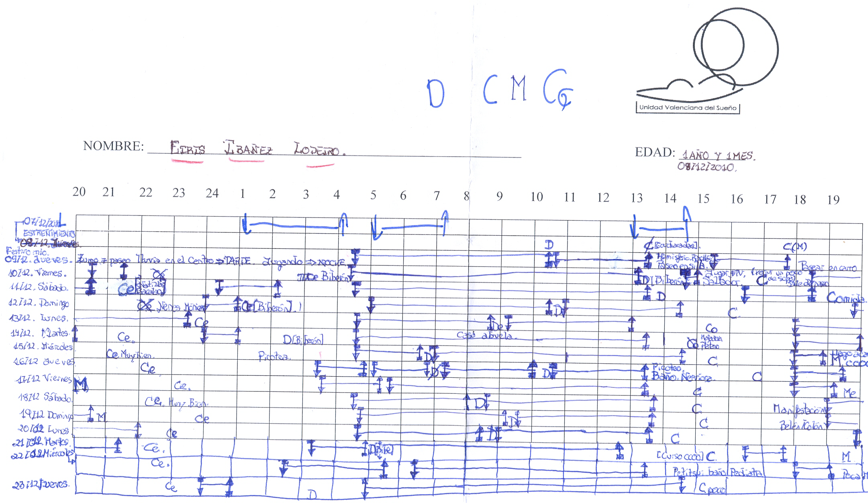
Notes:
30

Slide 31
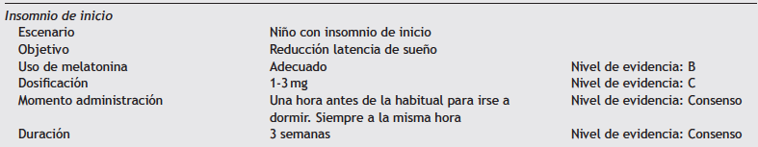
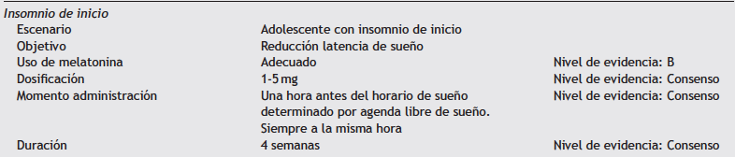

TRATAMIENTO FARMACOLÓGICO INSOMNIO /SRF
Fármaco 1ª elección: MELATONINA.
Duración: 3 semanas continuadas.

Slide 32
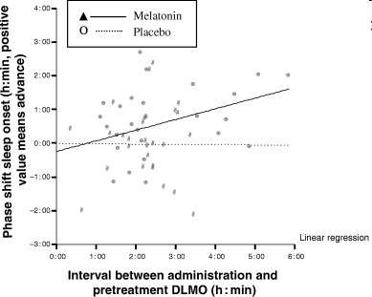
Smits et al. Journal Sleep Research.2005;14(2):187-194
Notes:
the advance of sleep onset increased by 0:19 hours, for every 1 h increase in the interval between melatonin administration and pretreatment DLMO. However, the results predict a delay of sleep onset when this interval was shorter than 0:46 hours.
show that the earlier melatonin is administered within a window of 0:46–6:00 hours of DLMO, the larger the phase-advance of sleep onset

Slide 33
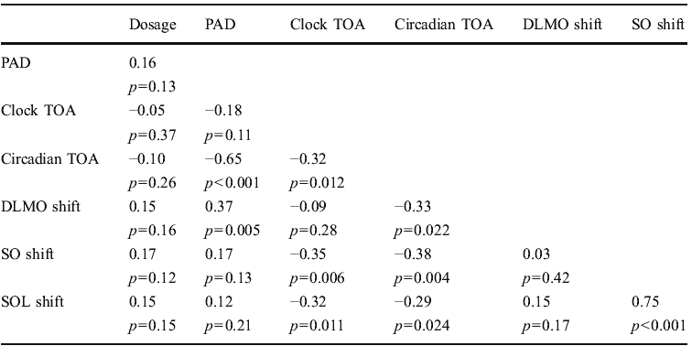
Melatonina: F. cronobiológico
¿Cuándo administrarla?
X
X
¡¡ Agenda libre previa !!
DLMO: Inicio pico melatonina SO: Inicio de sueño. SOL: Latencia de sueño. PDA: Angulo de diferencia de fase Circadian TOA: Momento circadiano de administración. Clock TOA: Hora del día de la administración
“melatonin administered at an inappropiate time can actually worsen the patient´s condition. “. Sleep Medicine Reviews. 2009;13:47-60
Psychophrmacology (2010) 212:379-391
Notes:
El cambio del momento de secreción de melatonina se correlaciona significativamente con el momento circadiano de la administración de la melatonina y con el angulo de diferencia de fase( PAD:refleja la distancia en tiempo entre el DLMO basal y el momento basal medio de inicio de sueño según actigrafia) y no con el momento de reloj horario de la administración. La magnitud del cambio en el inicio del sueño no se relaciona con la dosis si no con el momento de la administración. Es necesario determinar previamente al uso de la melatonina el DLMO (agenda)

Slide 34
Anamnesis
Agenda libre 15 dias / MELATONINA SALIVAL
INSOMNIO C.I.
SRF
RELOJ HORARIO:1-2h.
RELOJ CIRCADIANO: 4-6h.
LUMINOTERAPIA
CRONOTERAPIA
TERAPIA CC
HIGIENE DE SUEÑO

Slide 35
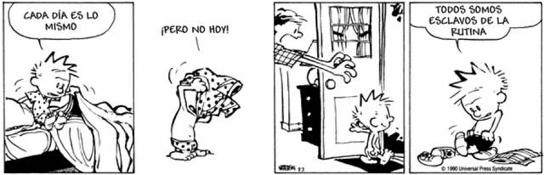
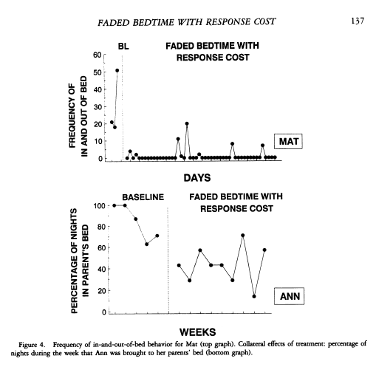
S = T x P
Restricción de sueño:80%

Slide 36
Caso clínico 2 (I)
Edad 6.9 años.
Motivo de la consulta:
  Le cuesta dormirse y se despierta mucho.
  Cuando duerme ronca mucho y se queda parado, suda y han de cambiarle la camiseta interior.
  Duerme con la madre semisentado con almohadas (no se fia) según su madre duerme poco (6-7 horas).
P: 46,800 kg (PC >> 97); T: 130 cm (pc>97); IMC=27 (pc>>>97).
PSG: IAH 10.
OLR: “NO QUIRURGICO”.

Slide 37
Caso clínico 2 (II)
Se duerme sentado viendo la TV en el sofá: ronca.
“Siempre tiene muchos pitos”.
Empezó al poco tiempo de nacer.
Esta perfecto por el día.
Corre o camina y se fatiga.
Suda mucho: “como si le tiraran un pozal de agua”
Tratamiento actual:
Montelukast, budesonida, ipatropio, salbutamol y corticoides orales.

Slide 38
Pregunta 5
Actitud:
Cuestionarios + agenda.
Cuestionarios + iniciar tratamiento conductual.
Cuestionarios + agenda + tratamiento conductual + melatonina.
Agenda de sueño libre + cuestionarios + determinación de ferritina.

Slide 39
Fuente:www.aepap.org. www.sepeap.org

Slide 40
Fuente:www.aepap.org. www.sepeap.org

Slide 41
Pregunta 6
Actitud:
Remitir de nuevo a OLR.
Remitir a endocrino/nutrición.
Descartar narcolepsia.
Pruebas de alergia

Slide 42
6 meses evolución
NUTRICIONISTA : “HA PERDIDO 2.600 kg” . PESO: 51.100 ( 46,800 KGR ¿?).
LLEVA MONTELUKAST.
EJERCICIO: CAMINA 1H DIARIA PQ AL PRINCIPIO SE CANSABA MUCHO.
9 meses de evolución
Lo ven más motivado y preocupado.
Está en el equipo de fútbol (portero), entrena tres veces por semana.
Desde la última semana ya está dando toda la vuelta sin ahogarse.
Sigue con la medicación.
1año de evolución (8 AÑOS)
Lleva dos meses caminando 2 horas diarias.
Peso 54 (pc >> 97), Talla 134 (pc 90) IMC: 21,76 (pc 97)
Incremento de peso en 1 año: 7.2 kg (pc >> 97)
Incremento de talla en 1 año: 4 cm ( pc 3)
Ronca menos.
Lleva montelukast. Duerme más ( 8 horas )
Comedor escolar PSG: IAH = 5

Slide 43
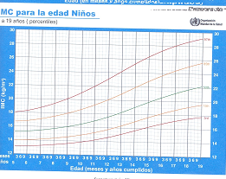
Sueño: 6-7 h
IAH: 10
Sueño: 8 h
IAH: 5

Slide 44
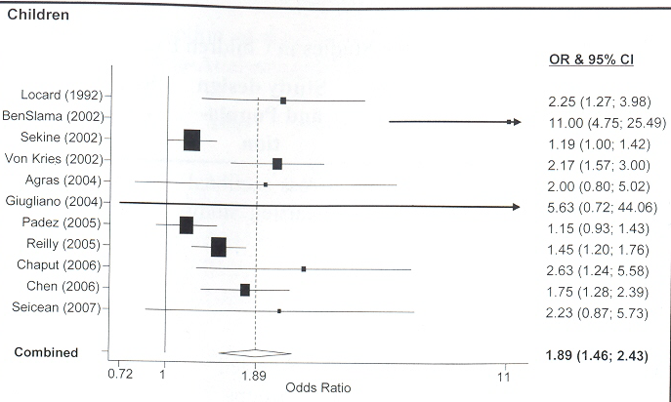
OR DURACION SUEÑO – OBESIDAD
(METAANÁLISIS)
EDAD
5
6-10
2-4
5-6
9.5
6-10
7-9
7
5-10
(N=656)
13-18
(N=509)
14-18
SLEEP.2008;31,5: 619-626

Slide 45
Presencia de TRS según el IMS (>85)
Ronquido habitual (más de 3 noches por semana) + respiración nocturna bucal + ESD
  N: 50 adolescentes IMC > p85 vs 39 con IMC< p85
  Control con PSG
Probabilidad diagnostica pretest:
    60,53 (IC 95%:49,54a 71,52)
Cociente de probabilidad positivo:
    5,09 (IC 95%: 2,48 a 28,58).
Cociente de probabilidad megatico:
    5,48 (IC 95%: 2,73 a 19,97).
Sensibilidad: 87.78 (IC 95%: 74.4 a 95.16)
Especificidad: 83.33 (IC 95%: 69,99 a 96,67)
VPP: 88.64 (IC 95%: 79.26 a 98.02)
VPN: 78.13 (IC 95%: 63.81 a 92.45).
Pin , Lluch et al Rev Esp. Ped 2008

Slide 46
Tecnología y sueño
“Los alumnos españoles comienzan a tener estos dispositivos a los 11 años, a pesar de que la edad recomendada son los 15 años. Sólo el 22% recibe formación en pensamiento crítico para valorar la fiabilidad de internet” El Mundo. 22.01.19.
Melatonin suppression and sleepiness in children exposedto blue-enriched white LED lighting at night. Physiological Reports ISSN 2051-817X

Slide 47
TV y videojuegos
Horas de sueño
Tecnología portátil
0 < 1 h 1 h 2 h 3 h 4 h
Horas al día de uso de tecnología portátil
Media de horas de sueño en días escolares en relación con las horas de TV, videojuegos y tecnología portátil (6 a 17 años de edad)

Slide 48
< 1 año
% con insuficiente sueño
2 a 5
6 a 10
11 a 13
14 a 17
0 < 1 h 1 h 2 h 3 h 4 h
Horas al día de uso de tecnología portátil
Porcentaje con insuficiente sueño según las horas de uso de tecnología portátil

Slide 49
Siestas según edad. Evitarlas en adolescentes
Desactivar. Rutina presueño
Evitar actividades estimulantes previo a acostarse
Actividad física diaria, no precia a acostarse
Exposición diurna solar
Horarios regulares
Condiciones ambientales
Medidas higiénicas

Slide 50
Para llevar a casa
Herramienta imprescindible en AP:
    La agenda de sueño.
Actitud saludable imprescindible:
  Respetar nuestros “relojeros” luz y ritmo alimenticio.
Actitud necesaria en la consulta:
    Ajustar las expectativas paternas.
Actitud educativa necesaria:
    Desactivar(nos) es la clave.

Slide 51
Lectura recomendable:

